Slide 1












ROBOTEX
Lina Shaabo
Nasiba Alchach
Aarthi Christina Aruliah
Layal Alzaydi
Whitney Trinh

Slide 2
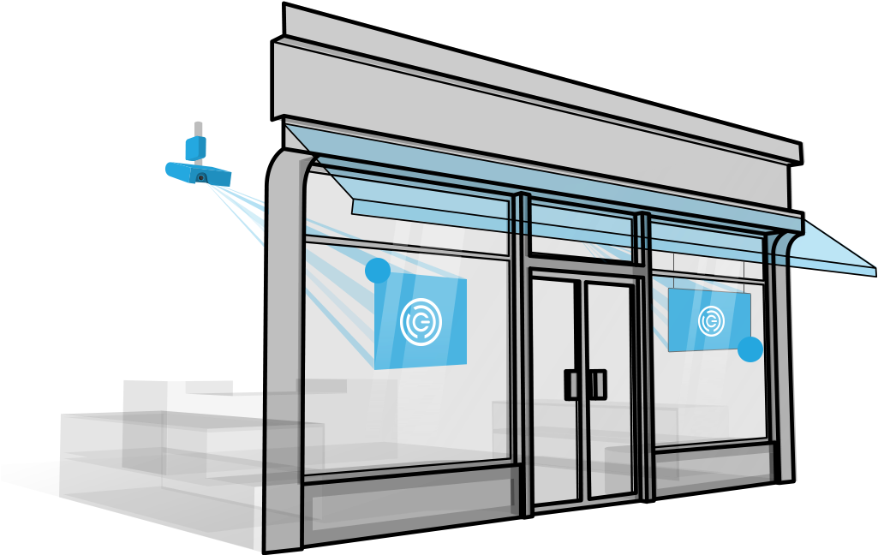
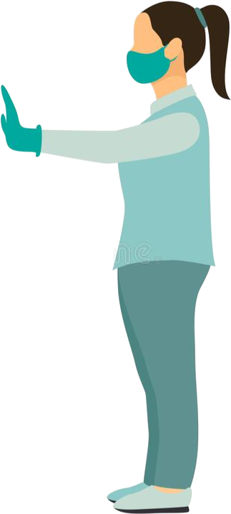
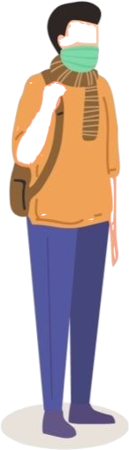
Problem Description
Problem
COVID-19 is putting frontline workers at risk as they work to ensure public health guidelines are being followed.
Implications
This not only puts frontline workers’ lives at risk but also customers and other workers inside the store.
ROBOTEX

Slide 3

Scope of Project
1
Design a reliable solution that can function independently
2
Protect frontline workers
3
Reduce the spread of COVID-19 by relying on an effective design that will promise safety to everyone in the community
ROBOTEX

Slide 4



Constraints
Ease of Use
Counter
Effectiveness
ROBOTEX

Slide 5




Criteria
Cost
Complexity
Accuracy
Environmental Impact
ROBOTEX

Slide 6







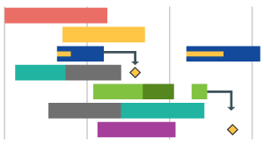

Tools used to support design
Decision Matrix
GANTT Chart
ROBOTEX

Slide 7

Design process
1. Problem identification
2. Gathering Information
3. Concept ganeration
4. Initial solutions and designs
5. Decision Matrix
6. Evaluating the designs
7. Preliminary Design
8. Apply technical calculation on the chosen design
8. Re-evaluate
10. Final Design
ROBOTEX

Slide 8
Decision Matrix
The Mobile Application | Existing Surveillance Camera | The Automated COVID Screening Station
6.275 | 6.945 | 7.62
ROBOTEX

Slide 9
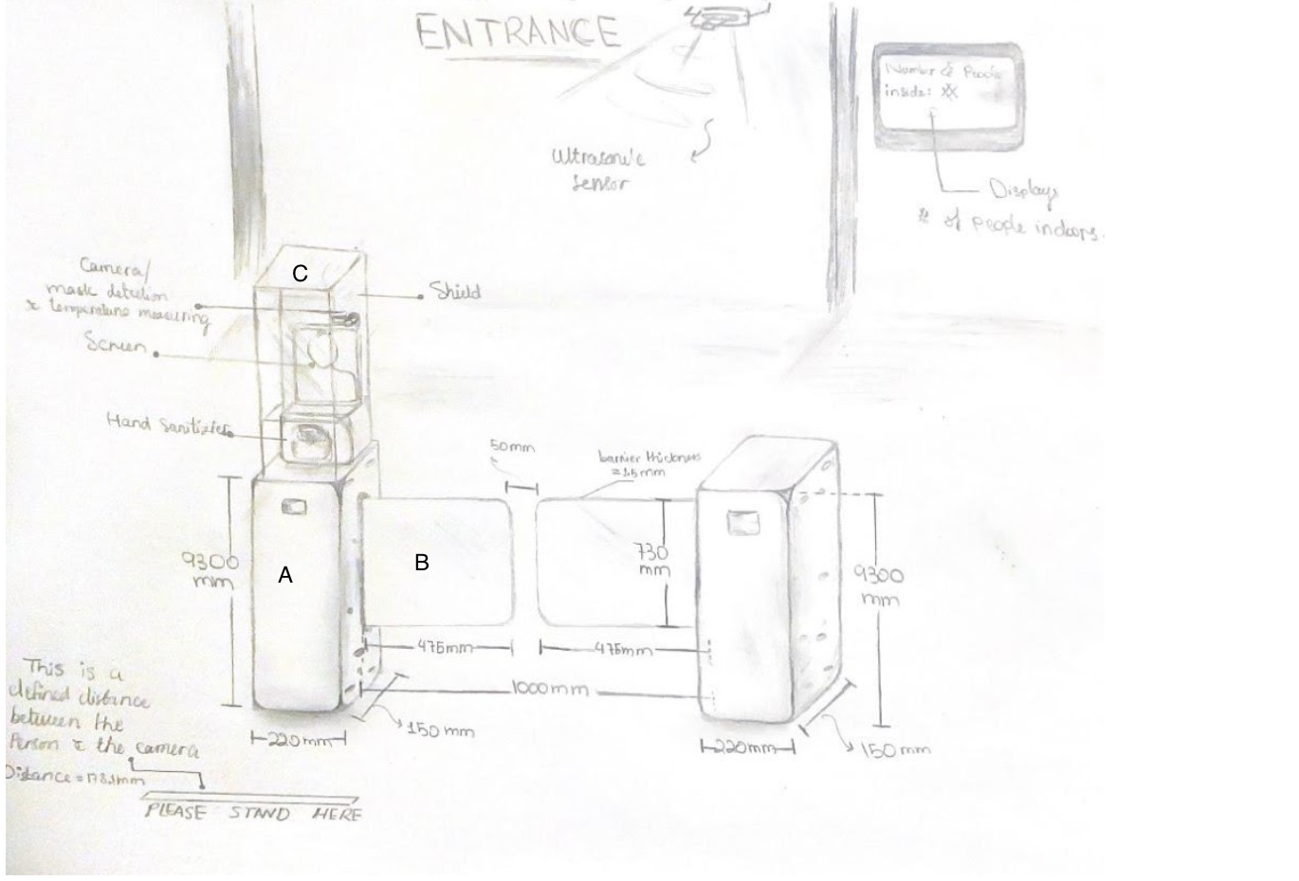
Design Solution
Materials
A
316L stainless steel
B & C
Polycarbonate plastic
Electrical Components
Raspberry pi
Raspberry pi v2 camera
DC motor
Arduino
Ultrasonic Sensor
Infrared temperature sensor
ROBOTEX

Slide 10
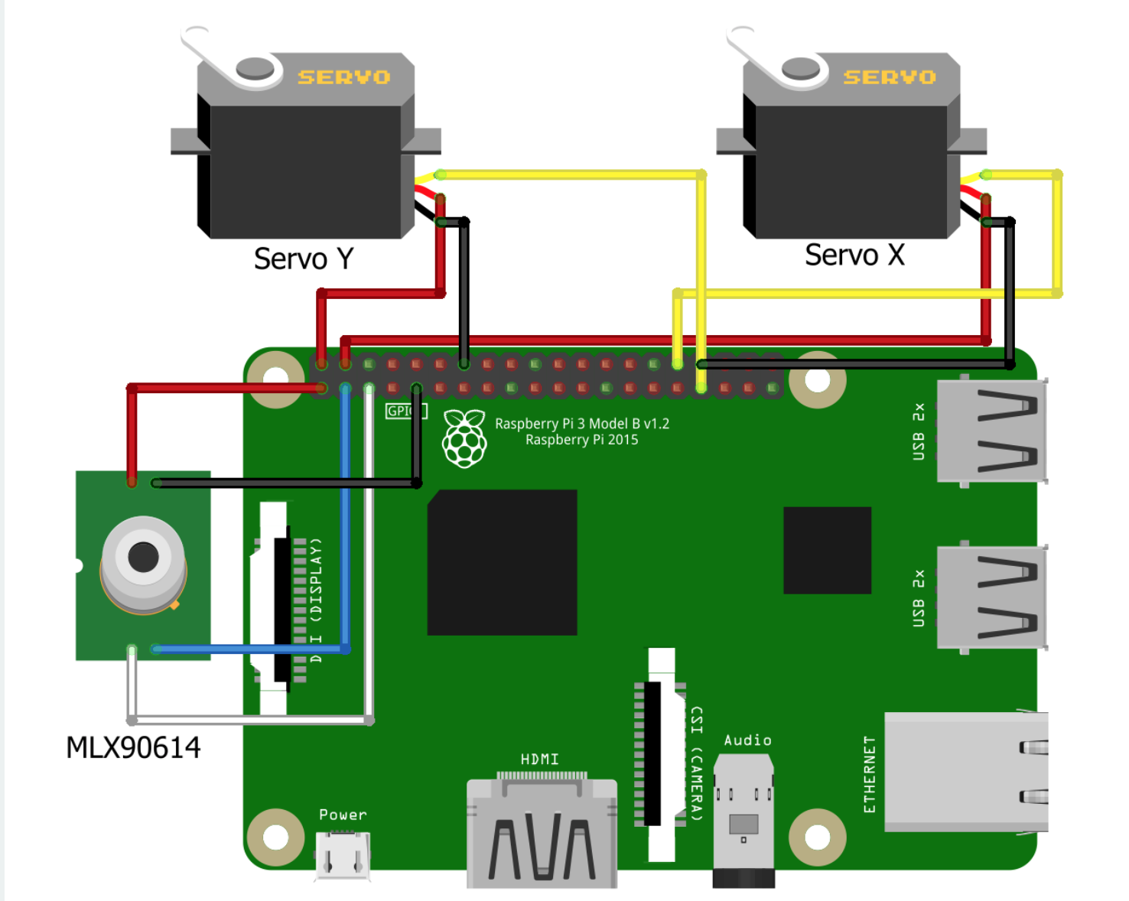
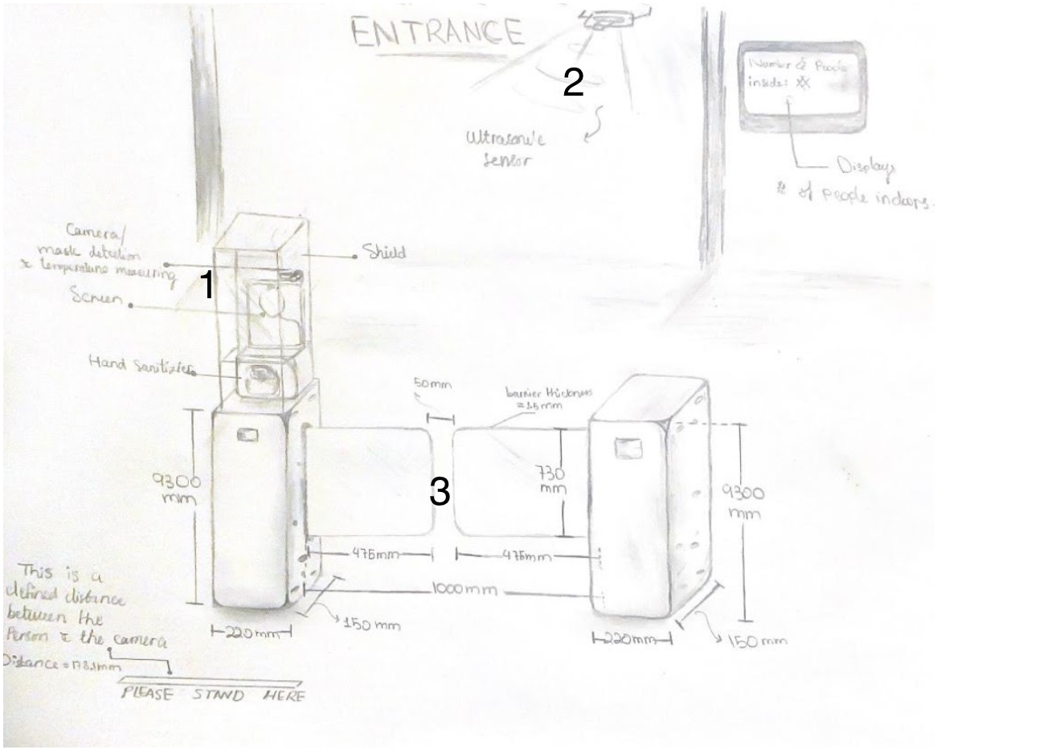
Design Solution Process
Step 1
Step 2
Step 3
Camera adjustment
Face mask detection
Temperature measure
Counting mechanism
Door control
1- https://create.arduino.cc/projecthub/sakshambhutani2001/touchfree-automated-temperature-checkup-and-mask-detection-2cc337
ROBOTEX

Slide 11
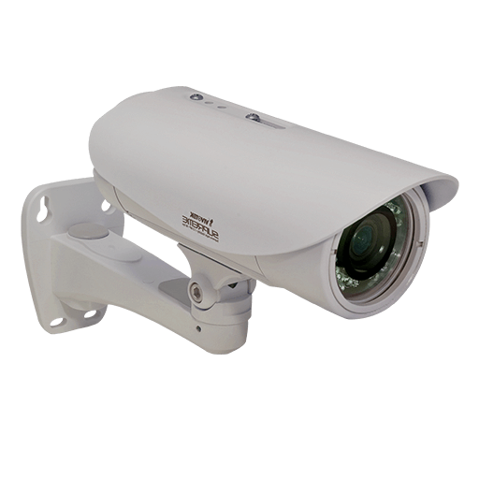
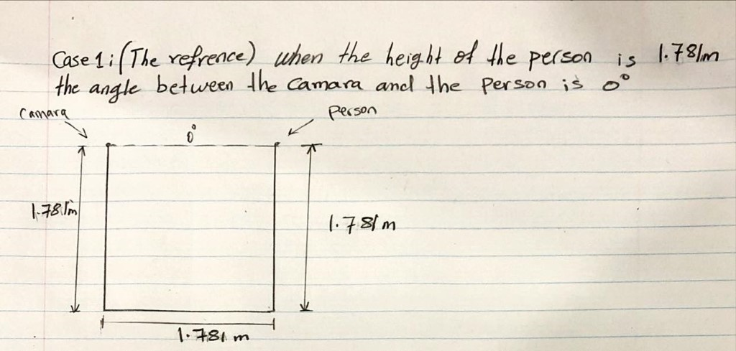
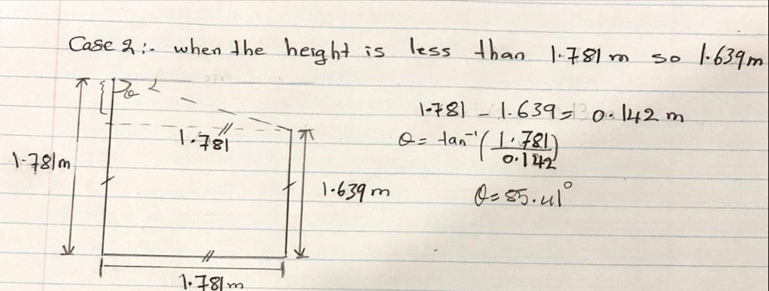
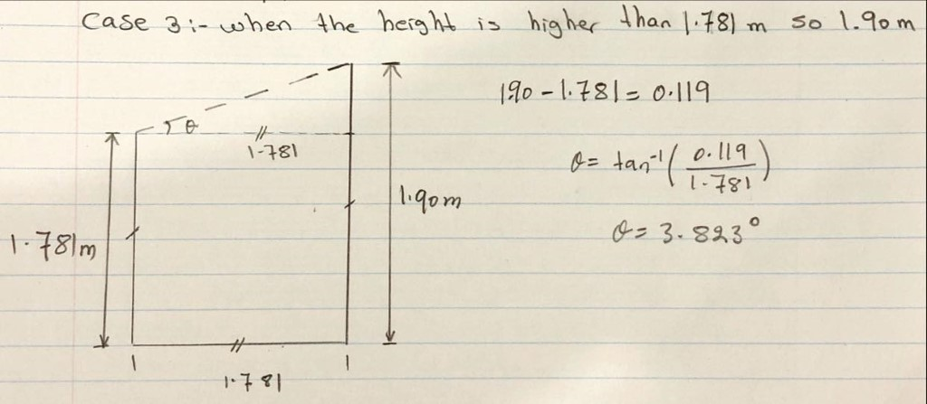
Design Solution
Camera Adjustment
1- https://www.cbc.ca/news/health/height-growth-canada-1.3695398
ROBOTEX

Slide 12
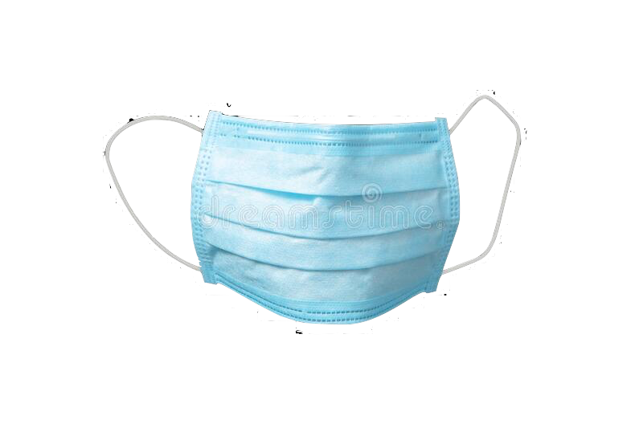
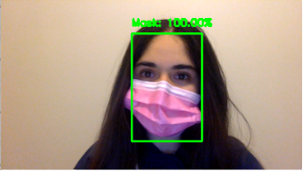
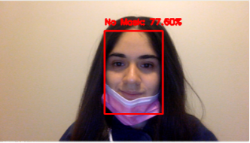
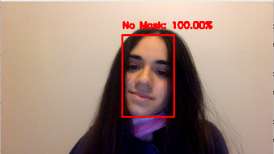
Design Solution
Face Mask Detection
100% Face Coverage
77.5% of the Face is not Covered
100% No Face Coverage
100%
77.5%
0%
ROBOTEX

Slide 13
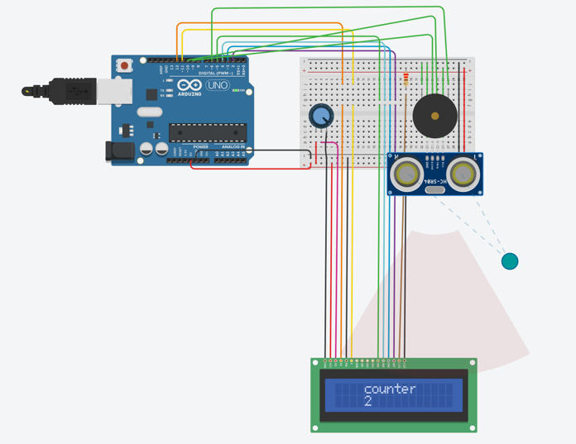
Design Solution
Counter Functionality
ROBOTEX

Slide 14
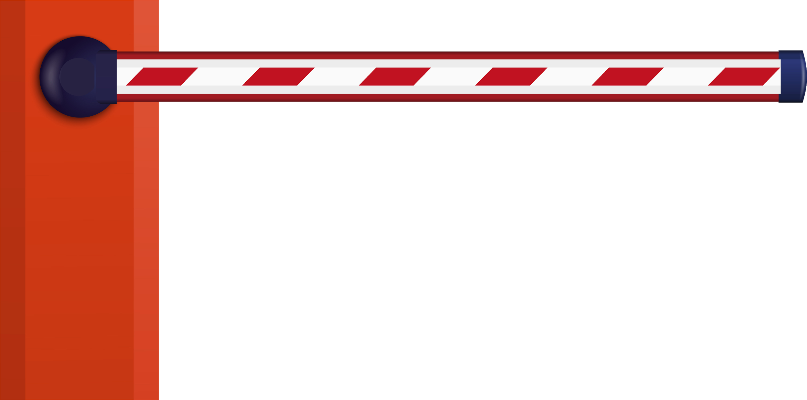
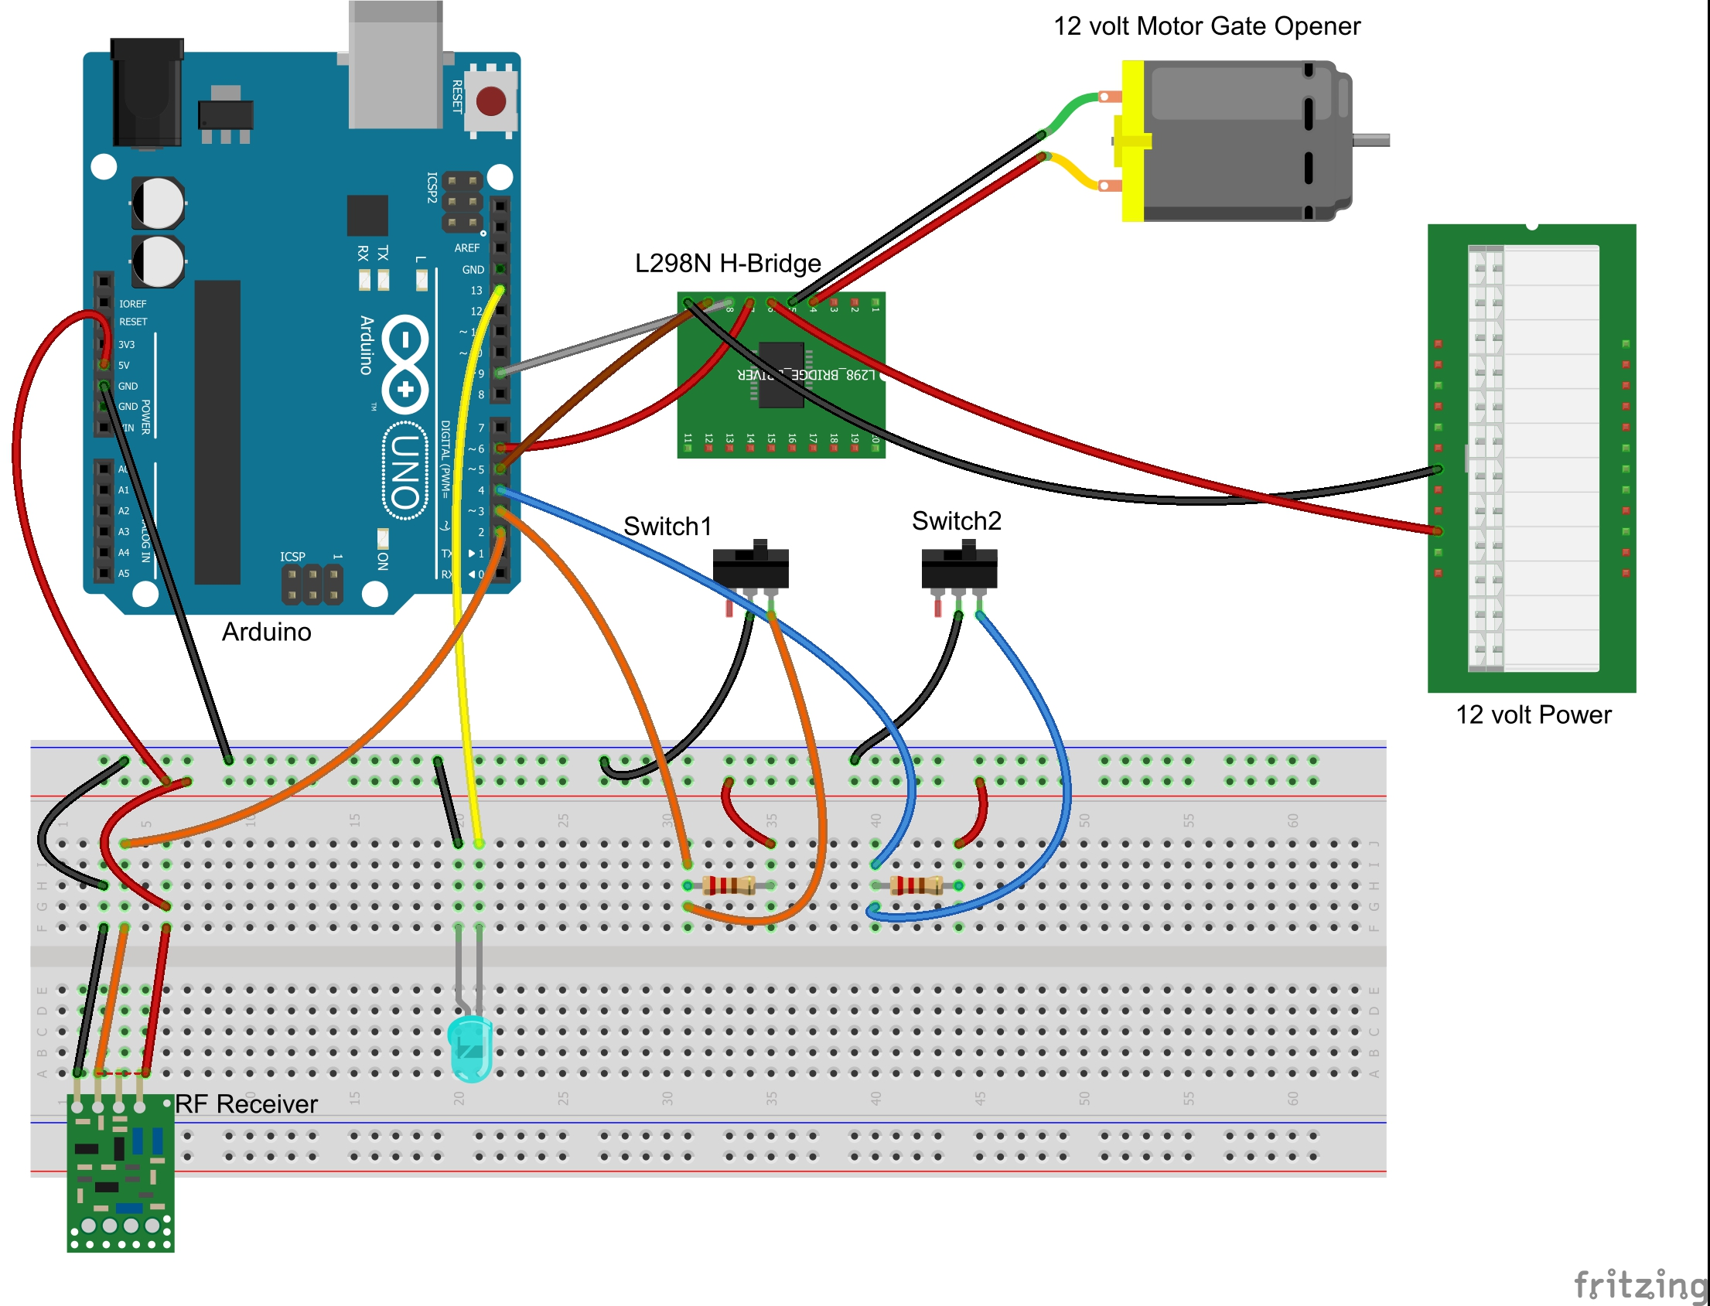
Design Solution
Door Barrier control
Newton’s Law
Conservation of Energy
Fatigue Analysis
ROBOTEX
1- https://forum.arduino.cc/index.php?topic=414908.0

Slide 15



Design Defence - Functionality
Temperature & mask detection Accuracy – 98% ¾ of LCD screen – light source during night | Camera Average height – 1.78 m [1] Servo motors – Tilt according to height | Barrier Gate More than 10 million cycles Accessibility – at least 950 mm [2] | Counter Unaffected by dust and sunlight Accuracy within 3mm
1- https://www.cbc.ca/news/health/height-growth-canada-1.3695398
ROBOTEX
2- https://guelph.ca/wp-content/uploads/Guelph_FADM_2015-06-30-FINAL.pdf

Slide 16


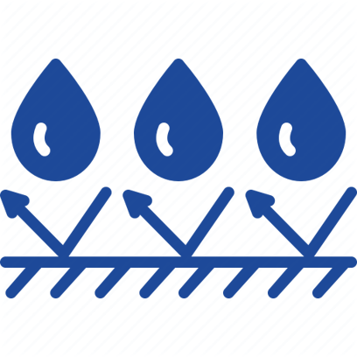

Design Defence - Functionality
Materials Selected
Outer Casing and shaded LCD screen | IP66 | Weatherproof
Barrier System | 316L Stainless steel | High corrosion resistance High Hardness
Barrier gates and Camera Enclosure | Polycarbonate Plastic | Weatherproof Transparency
ROBOTEX

Slide 17
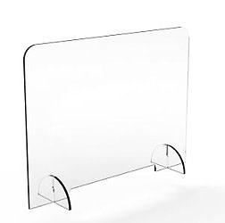


Design Defence - Safety
Protective Shield between Barrier Systems | High Accuracy – Increases safety of those who access the store | Hand Sanitizer Station along with the Barrier System
ROBOTEX

Slide 18


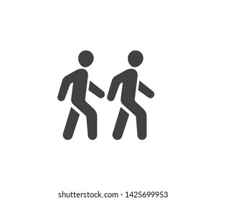
Design Defence – Risks and Uncertainties
Risk- More than one person entering the same gate at the same time
Solution : Cross check the outputs of the mask & temperature detection and the counter
Uncertainties- Store Location and Size
Solution : Customization of the design
ROBOTEX

Slide 19




Design Defence - Social Impacts
Reduces Anxiety
Lower Infection rate
Less Hospitalizations
Promoting Safe Practices
ROBOTEX

Slide 20
Design Defence - Economics
Items | Cost (CAD$)
Raspberry pi V2 camera | 43.80
Thermal sensor | 50.00
Ultrasonic sensor | 20.00
Barriers | 28.07
Counter screen | 1589.99
The overall metals | 10,243.95
Arduino's | 50.00
Camera Screen | 1508.62
Total | 13,534.43
ROBOTEX

Slide 21



Life Cycle Analysis
Global Warming Potential: 0.866 kMT of CO₂e
0.741
3.251
kMT of CO₂
mT of CO
0.095
1.217
kMT of CH₄
mT of NO_{X}
[1] Carnegie Mellon University Green Design Institute. (2021) Economic Input-Output Life Cycle Assessment (EIO-LCA) Canada 2002 (105 sectors) Producer model [Internet], Available from: <http://www.eiolca.net/> [Accessed 25 Mar, 2021]
ROBOTEX

Slide 22



Conclusion and Next Steps
Expanding screening technology to other symptoms
01
02
03
Integration into various work environments
Refining accessibility and accuracy
ROBOTEX

Slide 23
Thank you
ROBOTEX

